Slide 1
RAID types
RAID (Redundant Array of Inexpensive Disks or Drives, or Redundant Array of Independent Disks).
Purposes:
performance improvement (max. write read speed),
increased data security against hard drive failure.
Hardware RAID = RAID controller
or
Sofware RAID

Slide 2
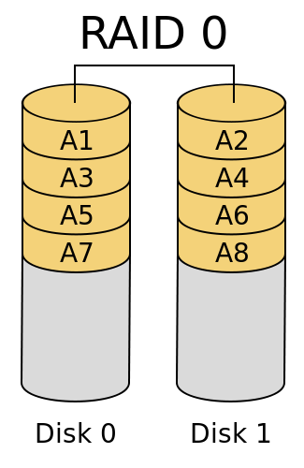
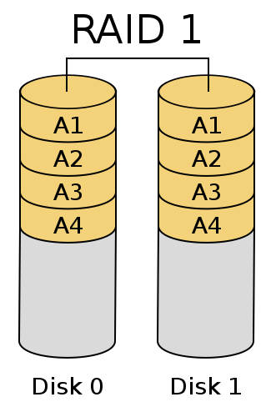
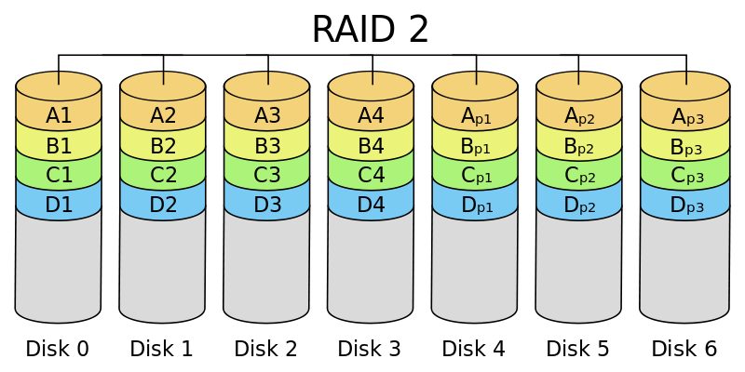
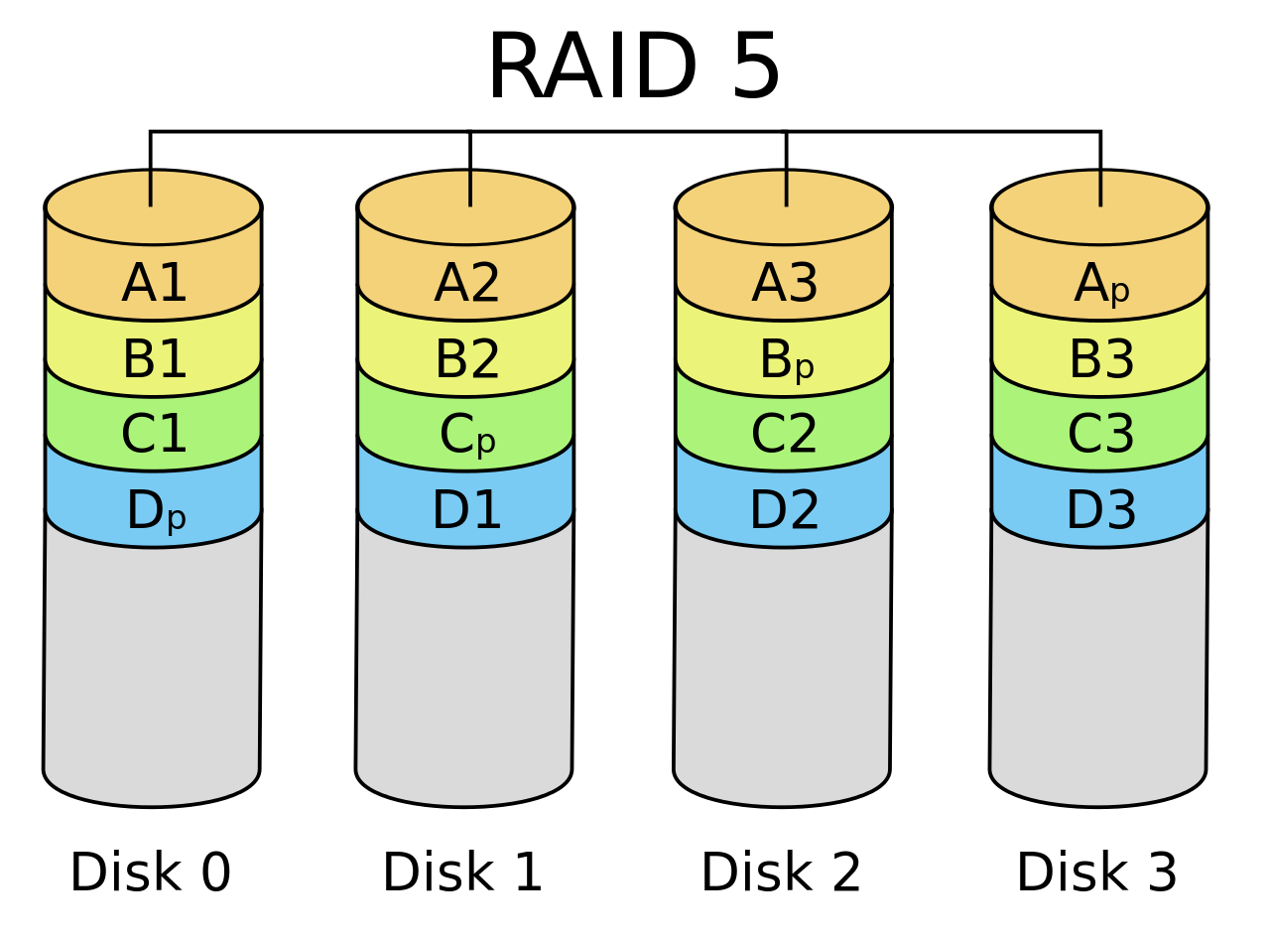
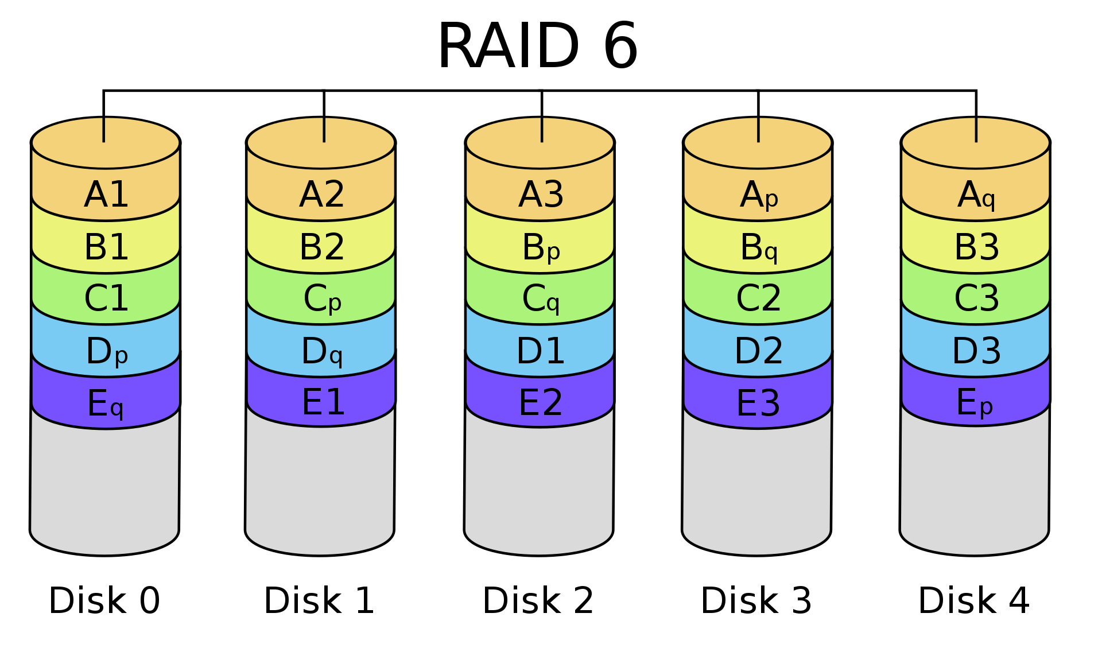
RAID types
(Hamming code)

Slide 3
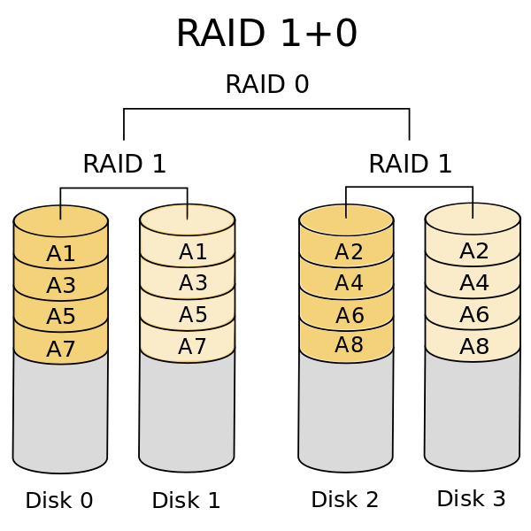
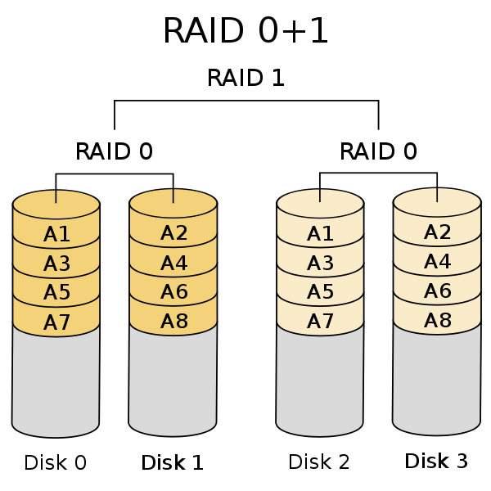
Mixed RAID types principle

Slide 4
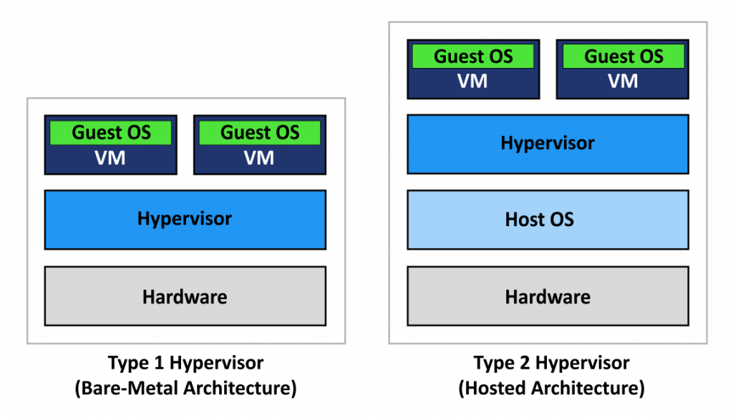
Virtual machine approach

Slide 5
Virtual machine approach
Vmware ESXi
Microsoft Hyper-V Server
Citrix XenServer
KVM
VMware Workstation
Virtualbox

Slide 6
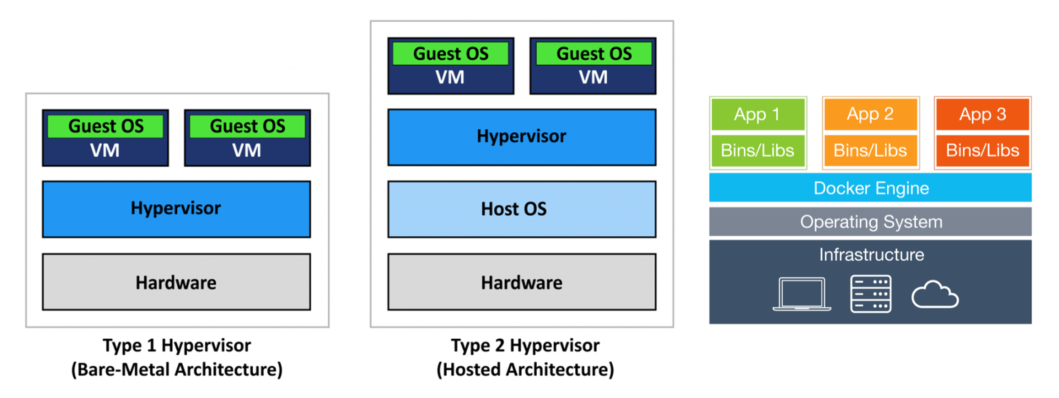
VM vs Docker
Docker

Slide 7
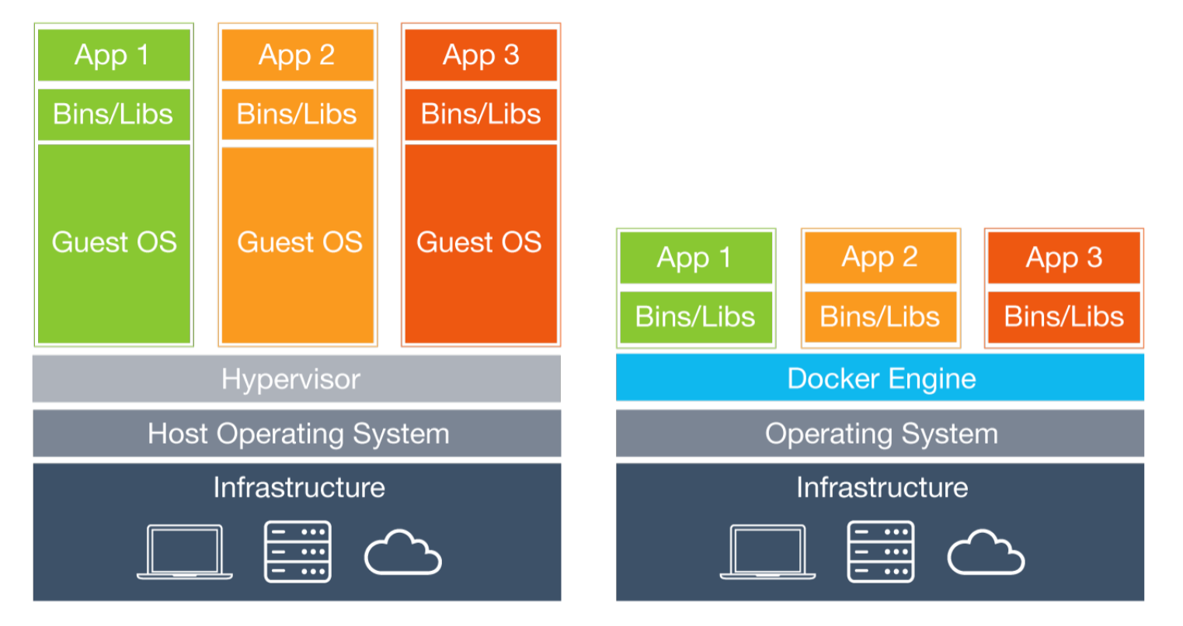
VM vs Docker

Slide 8
Docker Essentials
https://docs.docker.com/get-started/

